Slide 1


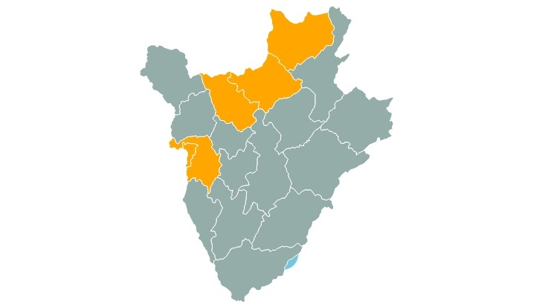
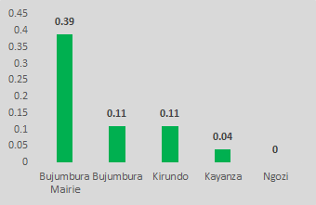

Assessment, feasibility, and acceptability of an adapted HIV risk screening tool to identify undiagnosed children living with HIV in Burundi
Alexandra C Vrazo¹, Adonis Ndayizeye², Honorat Gbais², Anouk Amzel¹, Delivette Castor¹, Aisha Yansaneh¹, Lindsey Filiatreau¹, Jepkoech Kottut¹, Josephine Niyonkuru³, Fatim Dia³, Damien Nimpagaritse³, Clement Niyonsaba², Bonaparte Nijirazana², Gina Etheredge⁴
¹United States Agency for International Development (USAID), Office of HIV/AIDS, Washington, DC, USA, ²FHI 360 Reaching an AIDS-Free Generation (RAFG), Bujumbura, Burundi,
³United States Agency for International Development (USAID), Health Office, Bujumbura, Burundi, ⁴FHI 360, Washington, DC, USA
Background
Methods
Results
Conclusions/Recommendations
Identifying children living with HIV (CLHIV) is difficult in very low prevalence settings.
Burundi is a low HIV prevalence country (0.9% adult prevalence) with estimated antiretroviral therapy (ART) coverage at 30% for children under 15 years old.
The study purpose was to assess the performance of an HIV risk screening tool to target testing to high-risk children at ambulatory/outpatient consultation in Burundi.
The objective was to validate the tool in this setting, and to assess feasibility and acceptability of the tool among health providers.
A nine-question HIV risk screening tool was developed to improve targeted testing and identify undiagnosed children with HIV, adapted from an existing pediatric screening tool from Zimbabwe.
The study was approved by the Burundi Ethics Committee and FHI 360’s Protection of Human Subjects Committee.
A cross-sectional study of 24,601 children aged 1-14 years seeking ambulatory services was implemented at 23 health facilities in five PEPFAR/USAID-supported provinces of Burundi (Bujumbura Mairie, Bujumbura, Kayanza, Kirundo, Ngozi).
The study was stopped early for futility after interim data analyses found a lower than expected positivity rate.
Of 16,786 children enrolled, 8,403 (50%) were female.
Eighteen children (0.11%) were HIV-positive; percent positivity was 0.07% (9/12,607) for children < 5 years and 0.22% (9/4,179) for those 5-14 years of age.
While validation of the screening tool was not possible, this study is the largest analysis of HIV positivity rates among children at the ambulatory entry point in Burundi.
Our findings suggest that whereas a pediatric screening tool may be feasible and acceptable to providers, routine ambulatory index testing is not an effective case finding strategy.
We recommend that Burundi’s HIV program include the two questions (parental death and persistent illness) into screening at pediatric ambulatory settings to continue further assessment of their performance.
We conclude that routine HIV testing in ambulatory settings is not an effective approach for identifying CLHIV, and that the program should focus on index testing while innovative approaches to testing are further developed and tested.
Figure 2: Study Sites
Figure 3: HIV positivity by province
Figure 1: Screening tool
Study population was children with either an unknown or undocumented HIV status, accompanied by a parent or caregiver 18 years of age or older.
After caregiver consent and child assent, all eligible children and caregivers were administered the screening tool, and all children were referred for HIV testing.
Descriptive and exploratory bivariate analyses were performed on quantitative data.
Qualitative data were collected through focus group interviews of 43 providers from nine study sites and summarized to identify themes.
No | Question | Response (Tick one ONLY)
Q1 a | Has the child been admitted to hospital before? | [ 0 ] No [ 1 ] Yes [ 9 ] Don’t know
Q1 b | If yes to Q1a, was the child tested positive for malaria during the hospitalization? | [ 0 ] No [ 1 ] Yes [ 9 ] Don’t know
Q2 | Does the child have recurring skin problems? | [ 0 ] No [ 1 ] Yes [ 9 ] Don’t know
Q3 | Are one or both parents of the child deceased? | [ 0 ] No [ 1 ] Yes [ 9 ] Don’t know
Q4 a | Has the child had poor health in the last 3 months? | [ 0 ] No [ 1 ] Yes [ 9 ] Don’t know
Q4 b | If yes to Q4a, has the child tested for malaria in the last 3 months? | [ 0 ] No [ 1 ] Yes [ 9 ] Don’t know
Q5 | Has the child had a cough for at least two weeks, plus any of the following - weight loss, fever and /or a TB contact at home? | [ 0 ] No [ 1 ] Yes [ 9 ] Don’t know
Q6 | Has the child had recurring diarrhea? / Has the child had two or more episodes of diarrhea in the past 3 months? | [ 0 ] No [ 1 ] Yes [ 9 ] Don’t know
Q7 | What is the head of household employment status? | [ 1 ] Unemployed [ 2 ] Small Scale Farming [ 3 ] Employed on Monthly Salary [ 4 ] Self Employed [ 5 ] Others (Specify) [ 9 ] Don’t know
Q8 | Is the child currently attending school? (ASK FOR SCHOOL GOING CHILDREN ONLY) | [ 0 ] No [ 1 ] Yes [ 9 ] Don’t know
Q9 | Has the child missed school repeatedly because they were ill? (ASK FOR SCHOOL GOING CHILDREN ONLY) | [ 0 ] No [ 1 ] Yes [ 9 ] Don’t know
Bivariate analyses revealed associations between a positive HIV test and: 1) one or both parents deceased (OR=2.51, 95%CI: 1.05-5.96), and 2) missed school repeatedly due to illness (OR=7.89, 95%CI: 3.34-18.63).
Providers found the screening tool to be feasible and acceptable, with major themes, such as: commodity and human resources constraints, and maintaining efficiency in clinic flow.
Disclaimer: This poster is made possible by the generous support of the American people through the U.S. President’s Emergency Plan for AIDS Relief (PEPFAR) with the U.S. Agency for International Development (USAID. The information provided does not necessarily reflect the views of PEPFAR, USAID or the United States Government, and the contents of this poster are the sole responsibility of the authors.

